Slide 1
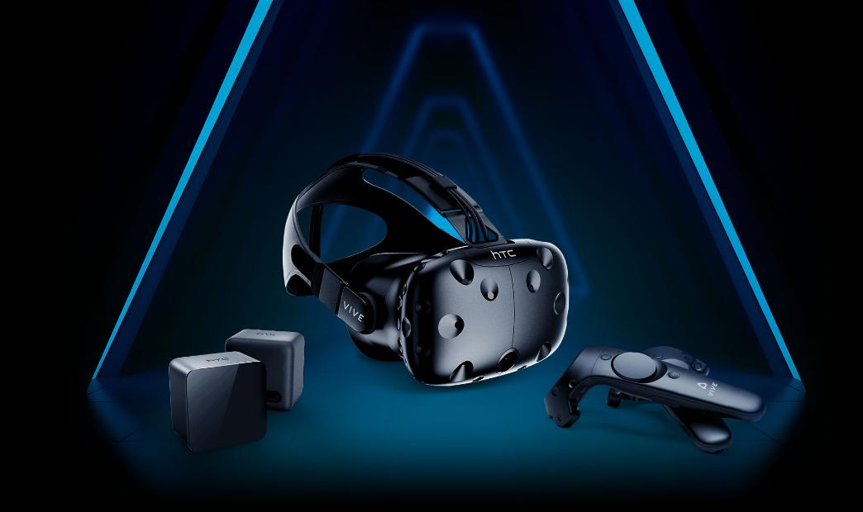
HTC VIVE
A VR headset developed by HTC & Valve Corporation to provide a room-scale immersive, interactive 3D user experience. Explore the technology behind it’s working & study potential improvements to the product to be added in future
Presented by,
Anu Mary Abey
S5 CSE ALPHA

Slide 2
INTRODUCTION
IMMERSION
Why do we need Virtual Reality (VR) Head Mounted Displays (HMDs)?
Provide the user a realistic & immersive simulation of a 3D 360° environment which can be experienced or controlled by the movement of the body
IMMERSION
3D
VR
INTERACTIVE

Slide 3
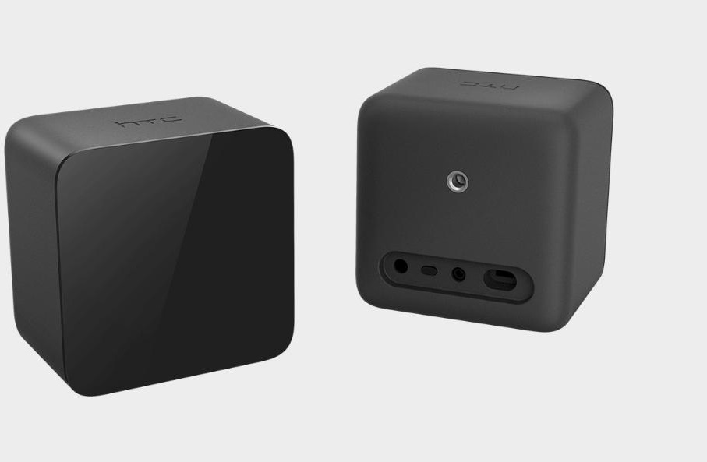
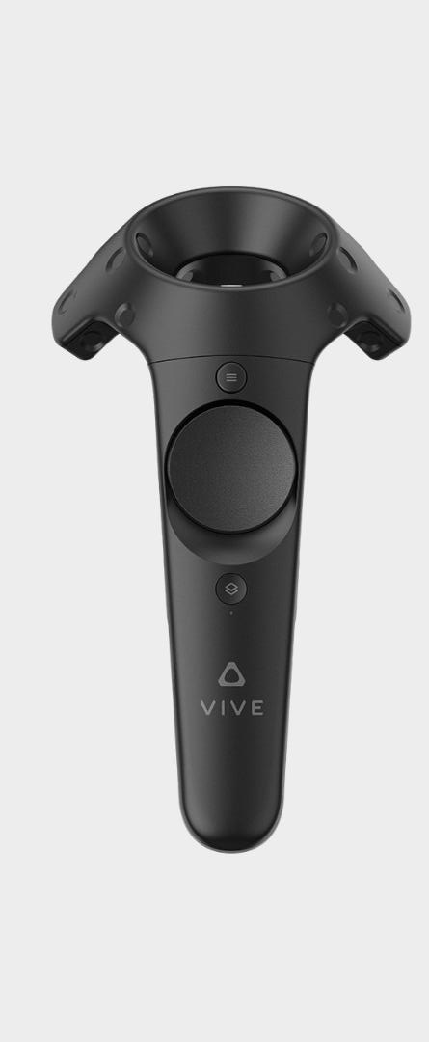
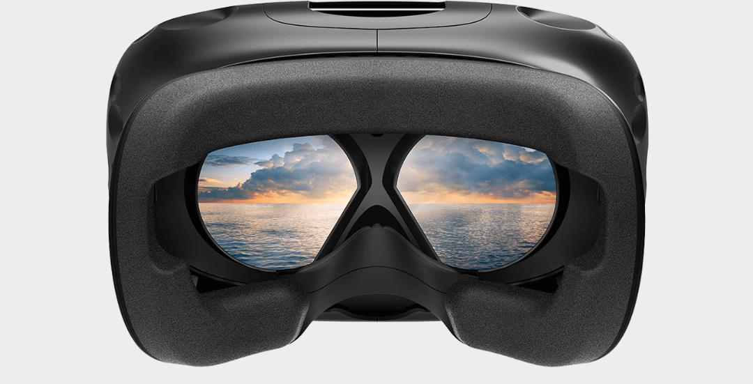
Lighthouse Base Stations
Headset with stereoscopic view
Controller
Notes:
Stereoscopic view

Slide 4
FEATURES OF HTC VIVE
Headset Specifications:
Screen: Dual AMOLED(Active Matrix Organic Light Emitting Diode) 3.6” diagonal
Resolution: 1080x1200 pixels per eye(2160x1200 pixels combined)
Refresh rate: 90Hz
Field of View: 110°

Slide 5
FEATURES OF HTC VIVE
Headset Specifications:
Safety Features: Chaperone play area boundaries & Front-facing camera
Sensors: SteamVR Tracking, gyroscope, proximity

Slide 6
FEATURES OF HTC VIVE
Controller Specifications:
Input: Multifunction trackpad, Grip buttons, Dual stage trigger, System button, Menu button
Platform/Operating System:
SteamVR running on MS Windows in addition to Linux & MacOS support
Notes:
The ring of the controller has 24 IR sensors that detect the base stations to determine the controller’s location. SteamVR tracks the controller location to a fraction of a millimeter with update rates from 250Hz to 1KHz

Slide 7
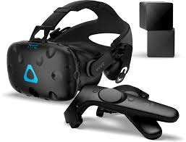
FEATURES OF HTC VIVE
Tracking System: Lighthouse (Two base stations emitting pulsed IR lasers)
Current Market Price: Rs 69,990
Weight: 555g(approx)

Slide 8
HOW DOES VIVE WORK?
Head & hand movements(translational & rotational) are mapped in a 360° virtual space using 37 sensors on the faceplates of the headset which is paired with Lighthouse base stations which emit infrared laser beams.
The base stations are set up to form a triangle forming the play area to triangulate your position.
Notes:
VR Components:
Virtual World, Interaction ( real time), Immersion
3D Modeling tools : Oculus Medium, Make VR
Even youtube supports VR - Cardboard view

Slide 9
HOW DOES VIVE WORK?
The laser from the base stations sweeps the room dotting all objects.
The headset records the time when it was hit by the laser and determines where each photosensor was at that particular point of time and when the beam was in contact with the headset to calculate the exact position relative to the base station

Slide 10
HOW DOES VIVE WORK?
A Chaperone system to detect any obstacles and notify the user along with front facing cameras

Slide 11
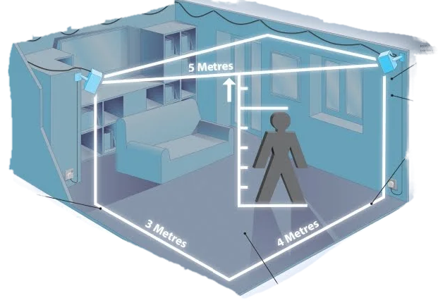
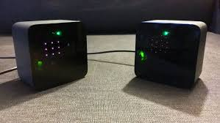

Slide 12
LIMITATIONS
High cost of equipment
Bulky and heavy headset
Limited field of view
Virtual space confined within a limited area
Hardware induced latency & difficulty in position tracking

Slide 13
IMPACTS
Health & Social Impacts :
Poor resolution & refresh rate causes cybersickness/VR sickness/motion sickness, dizziness & disorientation
Element of risk for users with medical history of seizures/epilepsy
Prolonged usage causes irritation of eyes
Risk of addiction
Loss of spatial awareness

Slide 14
FUTURE IMPROVEMENTS
Increased field of vision
Hand tracking without the use of controllers
Scale up the virtual space
Interconnected multiuser support

Slide 15
FUTURE IMPROVEMENTS
Reduce the bulkiness and heavy weight of the headset
Introduce parental control
Improve haptic feedback
Reduce cost

Slide 16
BENCHMARKING
NAME | CATEGORY | TRACKING | RESOLUTION(pixels per eye) | REFRESH RATE(Hz) | WEIGHT(g) | EQUIPMENTS | COST(Rs) | CONTROLLER
Samsung Gear VR | Mobile VR | rot | 1280x1440 | 60 | 345 | HMD Case, Phone | 11,990 | Touchpad & Back Button
Playstation VR | Console VR | pos+rot (external camera) | 960x1080 | 120 | 610 | HMD, camera, controller,game console | 25,990 | DualShock 4 controller, Playstation Aim, Playstation Move
Oculus Rift | High-end HMDs | pos+rot (external camera/lighthouse) | 1080x1200 | 90 | 470 | HMD, controller, high-end PC/laptop | 28,695 | Xbox One game controller, Oculus Touch motion tracked controllers
HTC Vive | High-end HMDs | pos+rot(external camera/lighthouse) | 1080x1200 | 90 | 555 | HMD, controller, high-end PC/laptop | 64,990 | SteamVR wireless motion tracked controllers

Slide 17
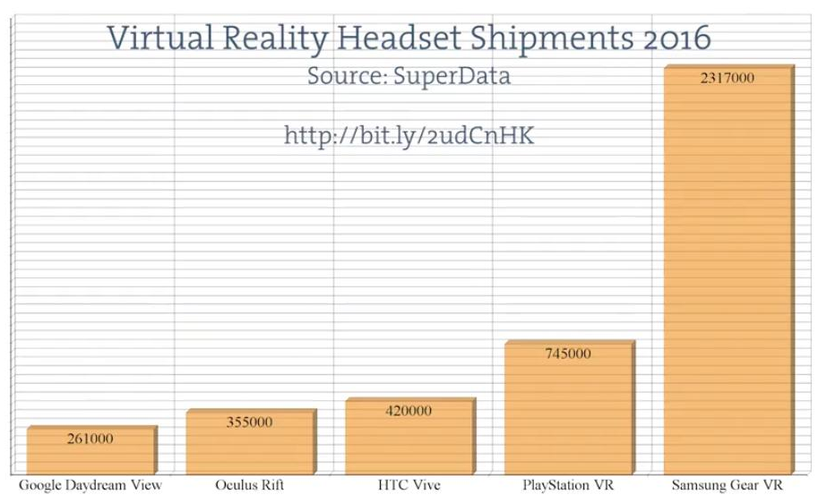
SALES STATISTICS, PRESENT MARKET & FUTURE BUSINESS OPPORTUNITIES
Present Market:
Gaming & Theme parks
Flight & Driving simulators
Scientific visualisation
Future Business Opportunities:
Medicine & Surgery
Education
Shopping & Tourism
Architecture

Slide 18
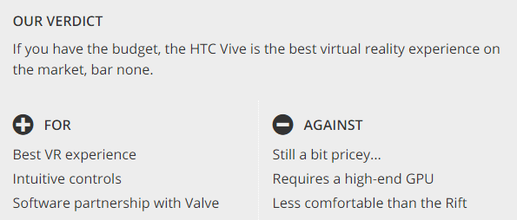
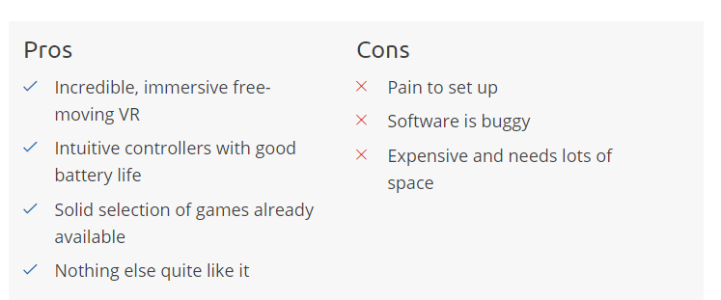
PATENTS & CUSTOMER REVIEWS
CUSTOMER REVIEWS:

Slide 19
CONCLUSION
HTC Vive is a high end HMD realizing the possibilities of tomorrow today. With future advancements in technology, the issues of providing a realistic & immersive 3D experience can be solved and possible side effects can be prevented.

Slide 20
BIBLIOGRAPHY
IEEE Articles:
Understanding Virtual Reality: Presence, Embodiment, & Professional Practice
Amplified Head Rotation in VR & Effects on 3D Search, Training transfer and Spatial Orientation
Performance and QoE Assessment of HTC Vive & Oculus
Rift for Pick and Place Tasks in VR
Online Course References:
edX: How Virtual Reality Works?
cousera: Introduction to Virtual Reality
Udemy: Virtual Reality: A Quick Introduction
Websites:
www.gadgetdaily.xyz
www.gizmodo.com
www.vrheads.com
www.wikipedia.org
www.ieeexplore.org
www.trustedreviews.com
www.techradar.com
www.vive.com
www.amazon.in
www.gadgets.ndtv.com
www.howstuffworks.com
www.youtube.com
www.roadtovr.com

